Slide 1
Requirements Engineering
Lecture 01-02

Slide 2
Software Engineering
Software engineering is the application of a systematic, disciplined, quantifiable approach to the development, operation, and maintenance of software, and the study of these approaches; that is, the application of engineering to software (SwEBOK).
What do we do with software?

Slide 3
Software-intensive System (SiS)
Software on its own is useless
Software can only do things when it is run on a computer platform, using various devices to interact with the physical world.
Systems in which software interacts with other software, systems, devices, sensors and with people are called software-intensive systems.
We must understand the “system” before engineering software.

Slide 4
What is a System?
Derived from the Greek word – Systema
An organized relationship among functioning units or components
Collins standard reference dictionary
A group of things or parts working together or connected in some way as to form a whole
The concise oxford dictionary
A complex whole; a set of connected things or parts; an organized body of material or immaterial things

Slide 5
Whole vs aggregate
Aggregate
A collection of individual, isolated components unrelated other than by spatial relationships or similarities of kind
Whole
A collection having emergent properties that belong to none of the component parts

Slide 6
System – IEEE std 1362-1998
A collection of interacting components organized to accomplish a specific function or set of functions within a specific environment
A group of people, objects, and procedures constituted to achieve defined objectives of some operational role by performing specified functions. A complete system includes all of the associated equipment, facilities, material, computer programs, firmware, technical documentation, services, and personnel required for operations and support to the degree necessary for self-sufficient use in its intended environment.

Slide 7
Software Ties the System Together

Slide 8
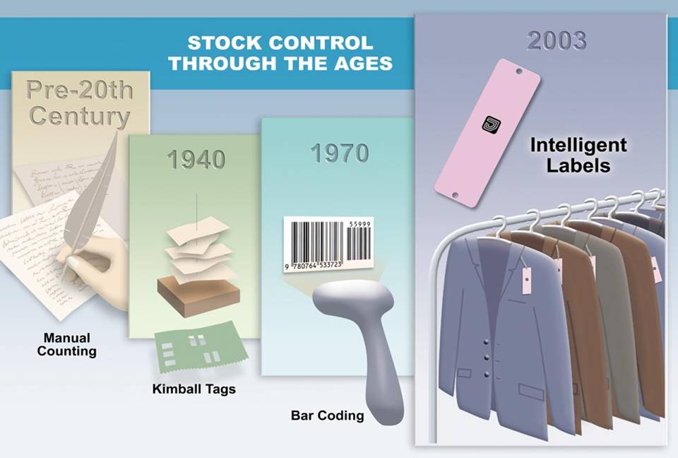
Intelligent Labels for stock Control

Slide 9
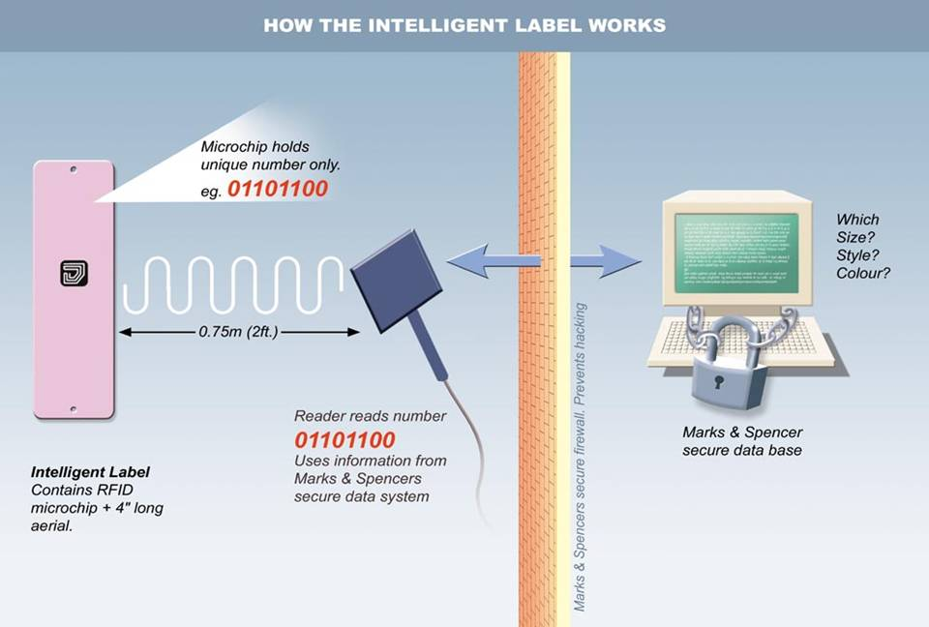
Privacy and the Intelligent Label

Slide 10
SiS and the four worlds
needs Information about
maintains Information about
Subject World
Uses
Usage World
System World
Contracts
Builds
Development World
Notes:
Subject World
the subject matter of the system:
Usage World
the environment within which the planned system will operate
System World
what the system does within its operational environment, what information it contains and what functions it performs;
Development World
the development process, team, schedule, required qualities (security, performance,…) etc.

Slide 11
Software for real world
To make sure a software solution “correctly” solves some real-world problem, we must first fully understand and define ...
what problem needs to be solved in the real world
the context in which the problem arises

Slide 12
Requirements Engineering
“The descriptions of the services and constraints are the requirements for the system
and the process of finding out, analyzing, documenting and checking these services and constraints is called Requirements Engineering.” (Ian Sommerville)
The use of term ‘engineering’ implies that systematic and repeatable techniques should be used

Slide 13
“Requirement” - The IEEE definition
A condition or capability needed by a user to solve a problem or achieve an objective
A condition or capability that must be met or possessed by a system or system component to satisfy a contract, standard, specification, or other formally imposed document.
A documented representation of a condition or capability as is 1 and 2

Slide 14
Requirements Engineering
Requirements Engineering
(RE)
RE is a set of activities concerned with identifying and communicating the purpose of a software-intensive system, and the contexts in which it will be used.
RE acts as the bridge between the real-world needs of users, customers, and other constituencies affected by a software system, and the capabilities and opportunities afforded by software-intensive technologies
The bridge

Slide 15
Requirements Engineering and SiS
The requirements express the purpose of such a system. They allow us to say something meaningful about how good a particular system is, by exposing how well it suits its purpose. Or, more usefully, they allow us to predict how well it will suit its purpose, if we design it in a particular way.
The idea of human-centred design is crucial – the real goal of an engineering process is to improve human activities in some way, rather than to build some technological artefact.
Requirements engineering applies to the development of all software-intensive systems.

Slide 16
The scope of RE: WHY, WHAT, WHO
System-as-is
System-to-be
WHY
a new system?
problems,
opportunities,
system knowledge
Objectives
satisfy
requirements,
constraints,
assumptions
WHAT
services?
assignment
WHO
will be responsible
for what ?

Slide 17
Key concepts: “is” vs. “ought”
Now
Future
Development
& delivery
Domain
Envt.
Sys.
The way things
are now
What we’ll make the system do
The way we’re assuming things will be

Slide 18
Example: Scheduling and Scheduler
Now
Future
Development
& delivery
Domain
Envt.
Sys.
How people schedule
What meetings are
Spec. of scheduler software
How people will schedule
What meetings will now be

Slide 19
Why RE?

Slide 20
Root Causes of Project Success and Failure
Lack of user input: 13 percent of all projects
Incomplete requirements and specifications: 12 percent of projects
Changing requirements and specifications: 12 percent of all projects

Slide 21
The hardest single part of building a software system
“The hardest single part of building a software system is deciding what to build. … No other part of the work so cripples the resulting system if done wrong. No other part is more difficult to rectify later”
F.P. Brooks

Slide 22
Requirements - a problem
Standish Group Report highlights “incomplete requirements” as major cause of software project failures.
"in reality, change of requirements is one of the main causes of project slippage and cost overruns“ (Berkely et al)
The failure of
FAA
CONFIRM
the Field System of the Department of Employment, UK
all highlight changing user requirements as one of the factors contributing to the failure.

Slide 23
Requirements - a problem
Users are changing requirements continuously

Slide 24
“No other part is more difficult to rectify later”
.1 - .2
.5
1
2
5
20
Requirements
Design
Coding
Unit Testing
Acceptance Test
Maintenance

Slide 25
The Road Map
Is this a need or a requirement?
Is this a nice-to-have or a must-have?
Is this a statement of the problem or a statement of the solution?
Is this a goal of the system or a contractual requirement?
Do we have to program in Java? Says who?
Who is it that doesn't like the new system, and where was that person when we visited here before?

Slide 26
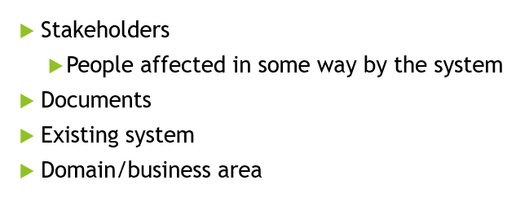
Sources of software requirement

Slide 27
Q&A

